Slide 1
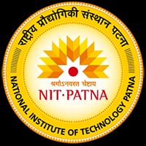

Water Management and Leakage Detection
To save and conserve water
Team Name: Team SEC#08

Slide 2
PROBLEM STATEMENT
Water Conservation and Leak Detection System
Using IoT sensors and advanced data analytics to monitor water usage and detect leaks in real-time. Provide actionable insights and recommendations to reduce water waste. Offering a subscription service app for water utilities and property management companies to manage and optimize their water infrastructure.
.

Slide 3
DESCRIPTION OF PROJECT IDEA
Research shows that worldwide, freshwater resources are rapidly diminishing, causing tension among different nations.
The primary reasons for this crisis are
uneven distribution of the water resources around the globe,
rapid growth in urbanization,
drastic increase in industrial activities, and
a lack of awareness about water consumption
Water is usually stored in the overhead or underground tanks. In addition, larger organizations (e.g., universities, factories, and malls) also fill tanks from their private tube wells.
The use of tube wells and over-pumping water from the underground resources lead to decreasing levels of fresh water, water pollution, and increased overall expenses associated with deeper drilling and pumping out of water.
Given the overall challenges in the fresh water supply crisis, preventing water wastage seems not only prudent but necessary.

Slide 4
HOW YOUR IDEA ACCOMPLISHES THE PROBLEM
Automatic monitoring of water levels in tanks
Automatic detection of water leakage from tanks and supply pipes in the proximity
Automated tanks refilling while avoiding the dry run of motors or pumps,
Providing access to the end-users to control and observe relevant activities remotely.

Slide 5
IDEA IMPLEMENTATION PROCESS
02
04
Reconditions and processes the data in a microcontroller
(Gate way unit)
End-Users to control and observe data (User Interface unit)
01
03
Monitor water leakage and detect water leakage using sensors.
(Sensor Gate unit)
Sending data to the Cloud
(Cloud Server Unit)

Slide 6
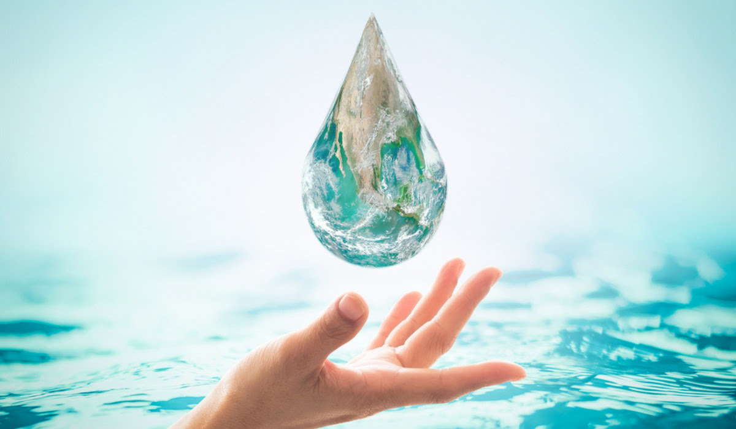
FUTURE ASPECTS
To attach machine learning algorithms that can learn date and optimize water usage in homes and businesses.These systems can identify patterns in water usage and make recommendations on how to reduce waste.
To detect water quality such as pH levels, temperature, and dissolved oxygen using smart sensors.
Moreover, we can expect in the use of IOT devices that can communicate with each other and share information about water usage and quality for better water management systems in every place on earth.

